Slide 1

Digital Electronic Circuits Section 1 (EE, IE)
Lecture 1

Slide 2
Why Digital?
Popular terms of current times:
- Digital Clock, Digital Camera, Digital Money, Digital Media, …
Prefix ‘Digital’ associates a term with digital technology.
Digital technology is considered more efficient for reasons such as:
- Easy to store, copy, compress - Immunity: noise, interference
- Various transmission options - Error correction, encryption
- Flexibility in processing - Analysis of data
- Inexpensive building block

Slide 3
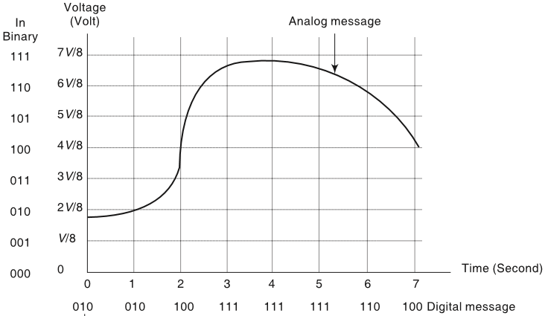
What is Digital?
Digital signals represent only finite number of discreet values (2 valued: Binary).
- Signal is discreet by nature - Signal, analog by nature, converted to discreet
Digital systems represent and manipulate digital signals.

Slide 4
Manipulation of Digital Signals
Switching is key to manipulation of digital signals.
Digital data storage involves switching.

Slide 5
Switching & Logic Operation
Realization of AND

Slide 6
Switching & Logic Operation
Realization of OR

Slide 7
Switching & Logic Operation
Realization of NOT

Slide 8
Switching Circuits
Realization of Tristate

Slide 9
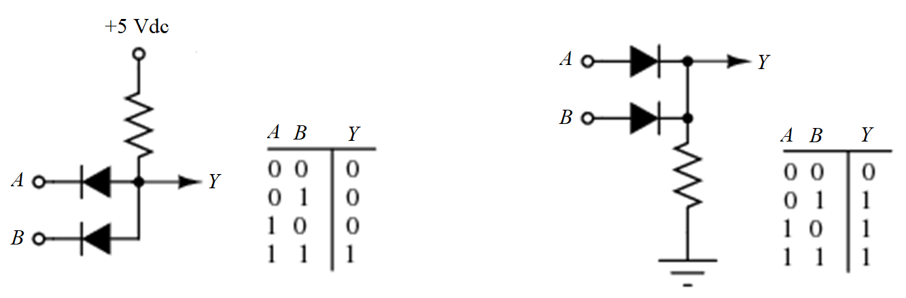
Diode as a switch
Realization of AND, OR logic
Possibility of realizing NOT logic

Slide 10
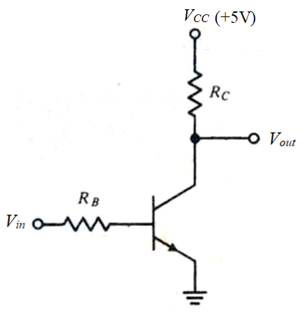
Transistor as a switch
Realization of NOT gate (inverter), Input-Output Characteristics
V_{out}
For quantitative analysis:
R_{B} = 10 kΩ
R_{C} = 1 kΩ
β_{F} = 50
V_{BE(ON)} = V_{BE(Sat)} = 0.7V
V_{CE(Sat)} = 0.2V
V_{OH}
5
4
(in Volt)
3
2
Cut-off
Active
Saturation
1
V_{OL}
1 2 3 4 5
V_{in}
V_{IL}
V_{IH}
(in Volt)

Slide 11
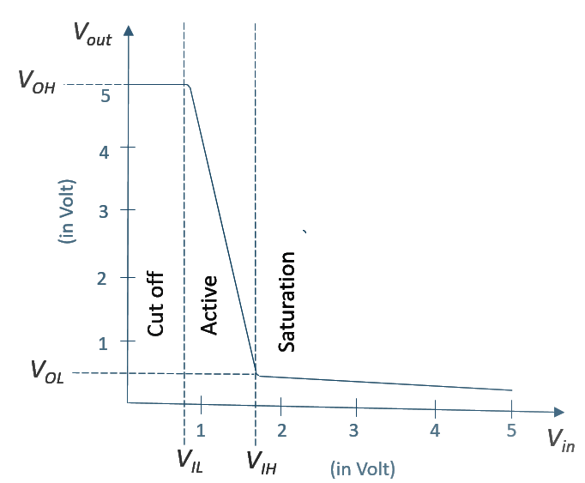
Transistor as a switch
EOC
Cut-off region
Base current I_{B} = 0 till V_{BE} < 0.7V i.e. V_{in} < 0.7V.
Transistor is cut off and I_{C} = 0 with V_{out} = 5V over entire range.
When V_{in} is increased beyond 0.7V, base current begins to flow and the transistor moves from cut off region to normal active region.
The coordinate, V_{in} = 0.7V, V_{out} = 5V mark first transition point in the transfer function of this circuit. This is also termed as breakpoint or edge of cutoff (EOC).

Slide 12
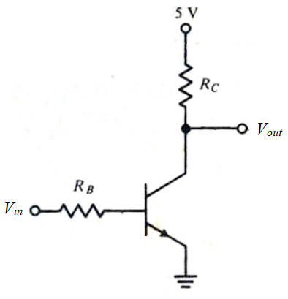
Transistor as a switch
Active region
Applying KVL along V_{in}, R_{B}, V_{BE}, Ground
I_{B} = (V_{in} – V_{BE(on)})/R_{B}
In active region, I_{C} = β_{F} I_{B} (as long as V_{CE} < V_{CE(sat)})
Applying KVL along V_{cc}, R_{C}, V_{CE}, Ground
V_{out} = V_{CC} - I_{C} R_{C} = V_{CC} - β_{F} I_{B} R_{C}
Combining,
V_{out} = V_{CC} - β_{F} R_{C} (V_{in} – V_{BE(on)})/R_{B}

Slide 13
Transistor as a switch
Saturation region
As V_{in} (or I_{B}) is increased a second transition point is reached when V_{out} = V_{CE(sat)}.
The values of I_{C} and I_{B} for this condition (the subscript EOS means edge of saturation):
I_{C(EOS)} = (V_{CC} – V_{CE(sat)})/R_{C} = (5-0.2)/1 = 4.8mA
and I_{B(EOS)} = I_{C(EOS)}/β_{F} = 4.8/50 = 0.096mA
Then V_{in(EOS)} = V_{BE(on)} + I_{B(EOS)} R_{B} = 0.7 + (0.096)(10) = 1.66V
Thus V_{in} ≥ 1.66V the transistor saturates. (Saturating Logic)
EOS

Slide 14
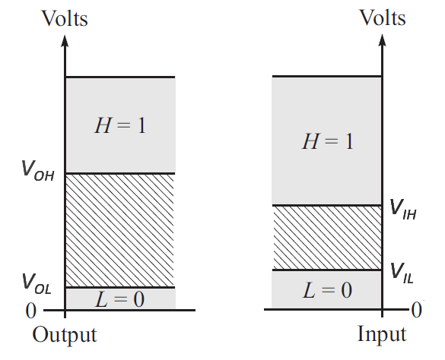
Input-Output Mapping
Noise Margin, Transition width and Logic swing
NM_{L} = V_{IL} – V_{OL} = 0.7 – 0.2 = 0.5V
NM_{H} = V_{OH} – V_{IH} = 5.0 – 1.66 = 3.34V
Transition width = V_{IH} - V_{IL}
= 1.66 – 0.7 = 0.96V
NM_{H}
L.S.
T.W.
Logic swing = V_{OH} - V_{OL}
= 5 – 0.2 = 4.8V
NM_{L}

Slide 15
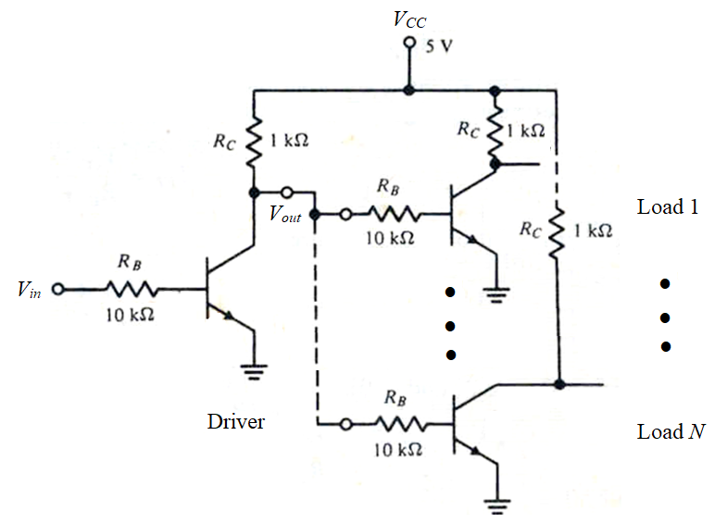
Fanout
Input to driver transistor: HIGH
When V_{in} is HIGH, driver transistor is saturated and V_{out} will be LOW.
With V_{CE(sat)} = 0.2V all the load gates will be in the OFF state.
No restriction on number of load gates

Slide 16
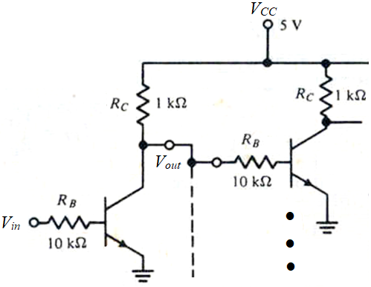
Fanout
Input to driver transistor: LOW
When V_{in} is LOW, driver transistor will be OFF and V_{out} will be at HIGH level.
A limit in the fanout is set when the voltage at V_{out} is insufficient to saturate load gate transistors.
Note that V_{IH} = 1.66V
For driver, I_{C(driver)} = (V_{CC} – V_{out})/R_{C} = (5 – 1.66)/1 = 3.34 mA
For load, I_{B(load)} = (V_{out} – V_{BE(sat)})/R_{B}
= (1.66 – 0.7)/10 = 0.096 mA
N = I_{C(driver)}/I_{B(load)} = 34.79 → 34

Slide 17
Fanout
Effect of noise margin
For a 0.5V noise margin,
Minimum HIGH level voltage at V_{out}
V_{OH} = V_{IH} + NM_{H} = 1.66 + 0.5 = 2.16V
Similar calculation as before with V_{out} at 2.16V gives
I_{C(driver)} = (V_{CC} – V_{out})/R_{C} = (5 – 2.16)/1 = 2.84 mA
I_{B(load)} = (V_{out} – V_{BE(sat)})/R_{B} = (2.16 – 0.7)/10 = 0.15 mA
N = I_{C(driver)}/I_{B(load)} = 19.4 → 19
An increased NM_{H} reduces fanout even further
Other factors:
Variation in β_{F}, V_{BE(sat)}, V_{CE(sat)}, V_{CC}, R_{C}, R_{B}.

Slide 18

References:
Grinich, V.H., and H.G. Jackson, Introduction to Integrated Circuits, McGraw-Hill
Donald P. Leach, Albert P. Malvino and Goutam Saha, Digital Principles & Applications 8e, McGraw Hill
Herbert Taub, and Donald Schilling, Digital Integrated Electronics, McGraw Hill
M. Morris Mano, and Michael D. Ciletti, Digital Design 5e, Pearson

Slide 19
https://tinyurl.com/DEC2020-Sec1-Quiz1
Time: 10 minutes

